Slide 1





PHARMACY MANAGMENT SYSTEM
TEAM MEMBERS:
K. AKHILA BHANU -25B11CS472
A.LAKSHMI AISHWARYA -25B11CS011
G.LEELA RAGHINI -25B11CS264
S.JAYA SAI MANIKANTA -25B11CS865

Slide 2

Introduction
*
A system to manage pharmacy activities digitally.
Stores details of medicines, customers, and suppliers.
Manages sales and purchase records.
Tracks medicine stock and expiry dates.
Reduces manual work and errors.
Makes pharmacy management faster and easier.
*
*
*
*
*

Slide 3
Why is the Project Needed
To manage medicines efficiently.
To keep accurate records of sales and purchases.
To track medicine stock easily.
To identify expired medicines.
To reduce manual work and errors.
To save time and improve pharmacy operations.

Slide 4
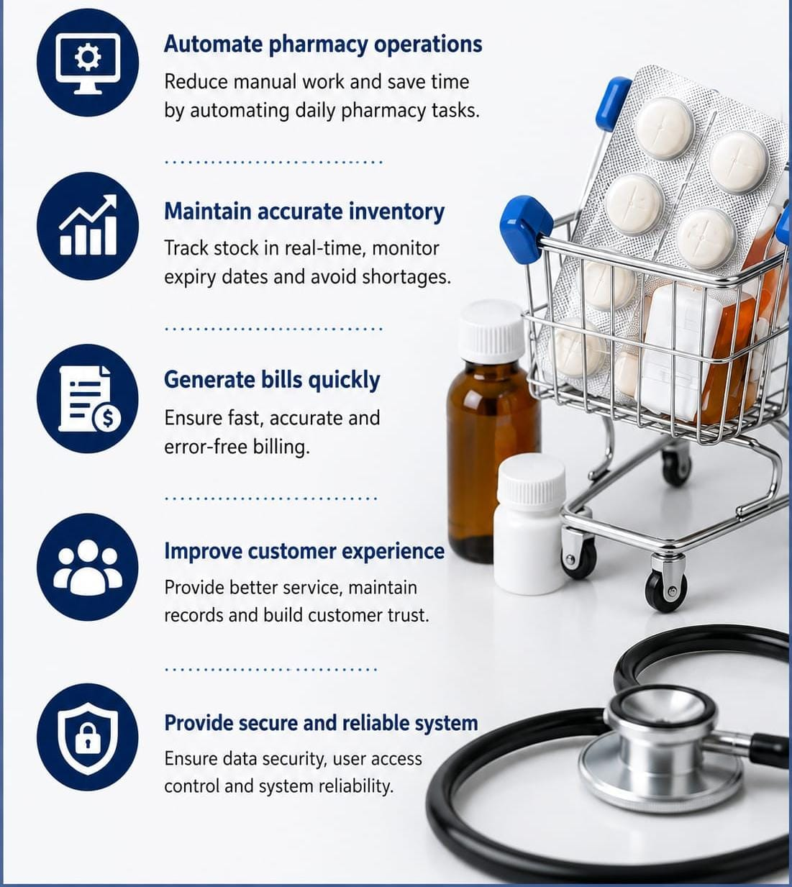
Objectives
*
Maintain medicine and category details in a structured database.
Track medicine stock, batch information, expiry dates, and prices.
Manage suppliers and purchase records.
Manage customers and sales/billing transactions.
Automatically update stock when medicines are purchased or sold.
Generate useful reports such as sales, purchase, and low-stock reports.
Reduce manual work and improve data accuracy and retrieval
*
*
*
*
*
*

Slide 5

Problem Statement
*
Traditional pharmacy operations often depend on manual records for medicines, suppliers, customers, sales, and stock.
Manual management can lead to incorrect stock counts, expired medicines being overlooked, duplicate records, and slow billing.
It is difficult to quickly identify low-stock medicines, sales details, supplier information, and purchase history.
The Pharmacy Management System provides a centralized database to manage these activities accurately and efficiently.
*
*
*

Slide 6
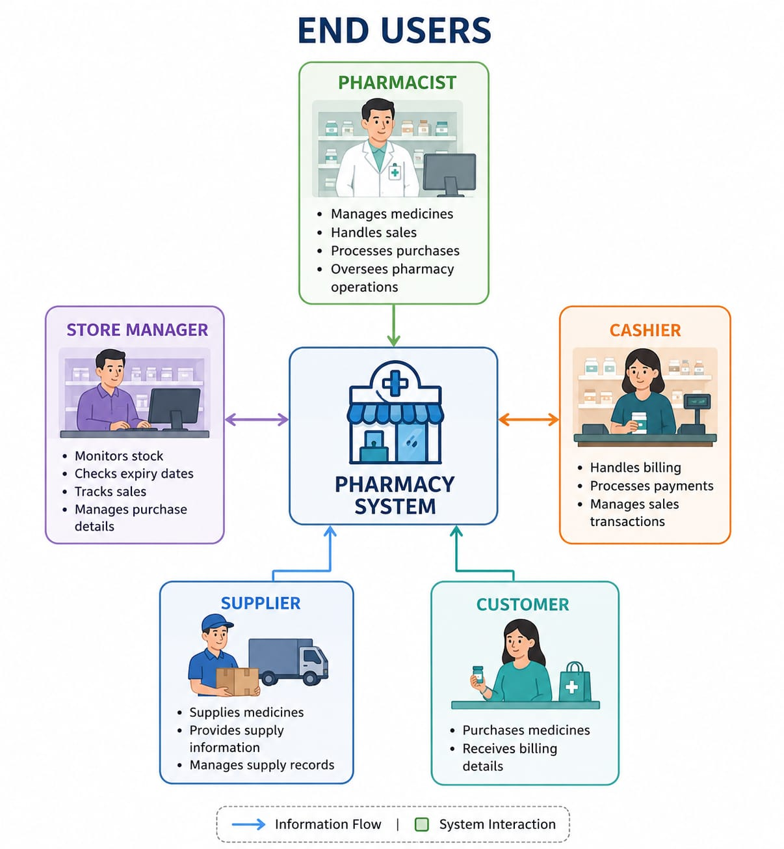
END USERS
Pharmacist – Manages medicines, sales, purchases, and pharmacy operations.
Store Manager – Monitors stock, expiry dates, sales, and purchase details.
Cashier – Handles billing and sales transactions.
Supplier – Supplies medicines and manages supply information.
Customer – Purchases medicines and receives billing details.

Slide 7
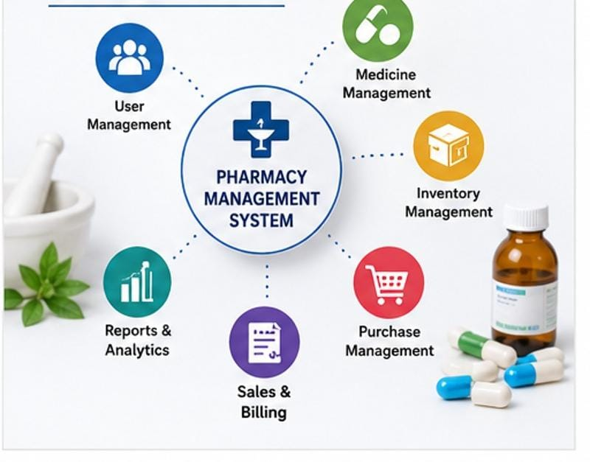
Main Modules
Medicine Management
*
*
Inventory Management
*
Purchase Management
*
Sales & Billing
*
Reports & Analytics
*
User Management

Slide 8
ENTITIES | ATTRIBUTES | PRIMARY KEY
Pharmacy | Pharmacy_ID, Pharmacy name, Address , Phone | Pharmacy_ID
Medicine | Medicine_ID, Expire date Medicinename, Category Manufacturer, Price | Medicine_ID
Supplier | Supplier_ID, Suppliername Phone , Email, Address | Supplier_ID
Customer | Customer_ID, Customername, Phone, Email , Address | Customer_ID
Sales | Sale_ID, Saledate, Customer_ID, Medicine_ID, Quality, Total amount | Sale_ID

Slide 9
RELATIONSHIP
CARDINALITY
Pharmacy has medicine 1:M
Supplier supplies medicine 1:M
Customer purchases medicine 1:M
Customer has prescription 1:M
Prescription contains medicine M:M
Pharmacy records sales 1:M

Slide 10
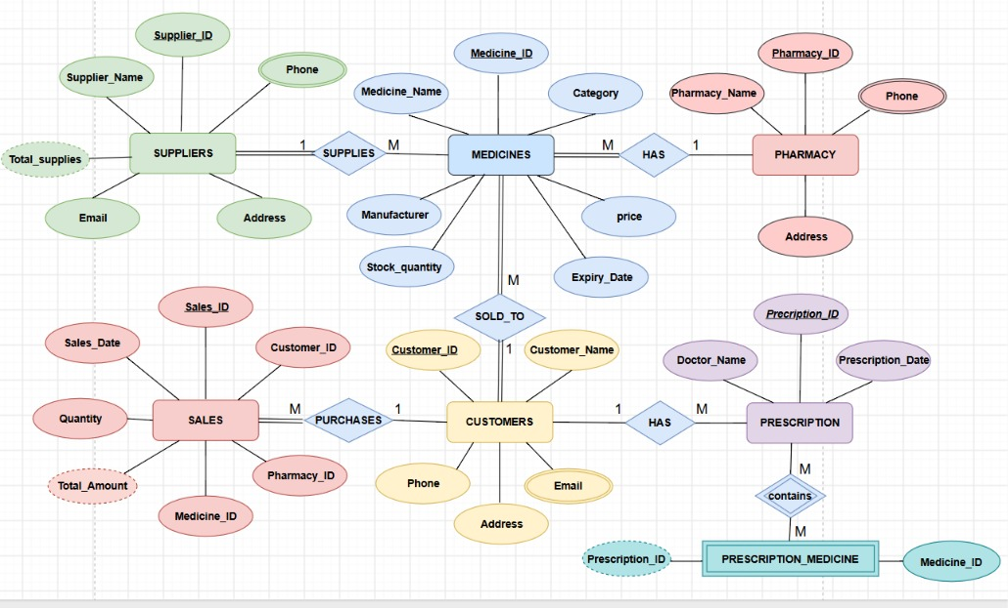
ER DIAGRAM

Slide 11

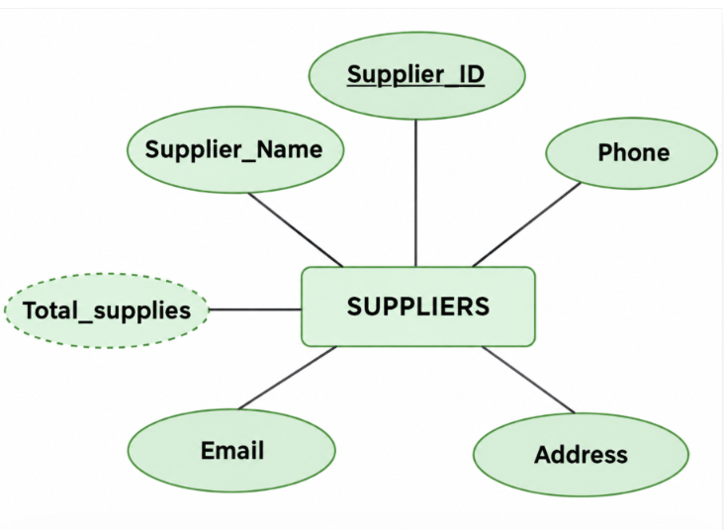
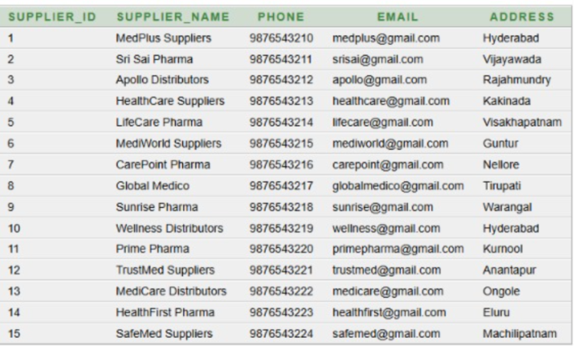
SUPPLIER TABLE
CREATE TABLE Suppliers1
(
Supplier_ID NUMBER PRIMARY KEY,
Supplier_Name VARCHAR2(100) NOT NULL,
Phone VARCHAR2(15),
Email VARCHAR2(100),
Address VARCHAR2(255)
);

Slide 12
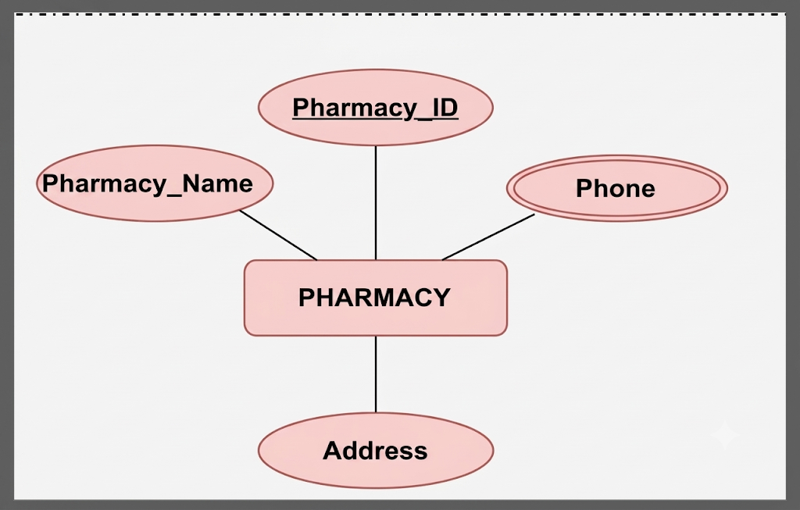
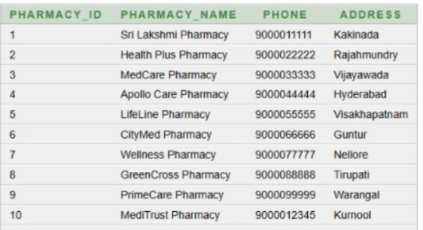
PHARMACY TABLE
CREATE TABLE Pharmacy1
(
Pharmacy_ID NUMBER PRIMARY KEY,
Pharmacy_Name VARCHAR2(100) NOT NULL,
Phone VARCHAR2(15),
Address VARCHAR2(255)
);

Slide 13
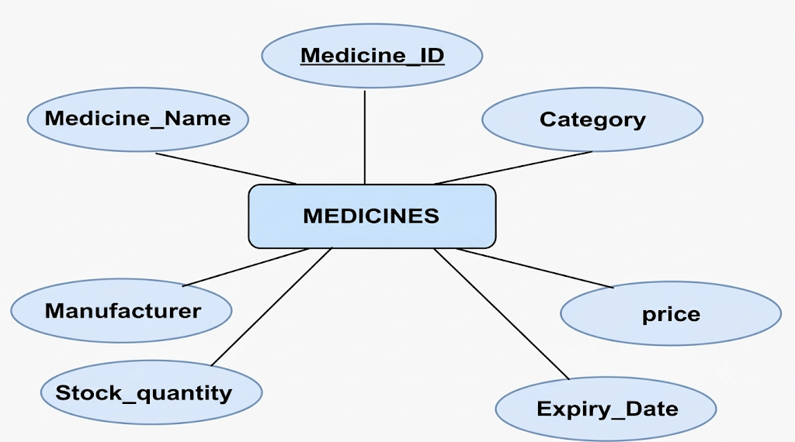
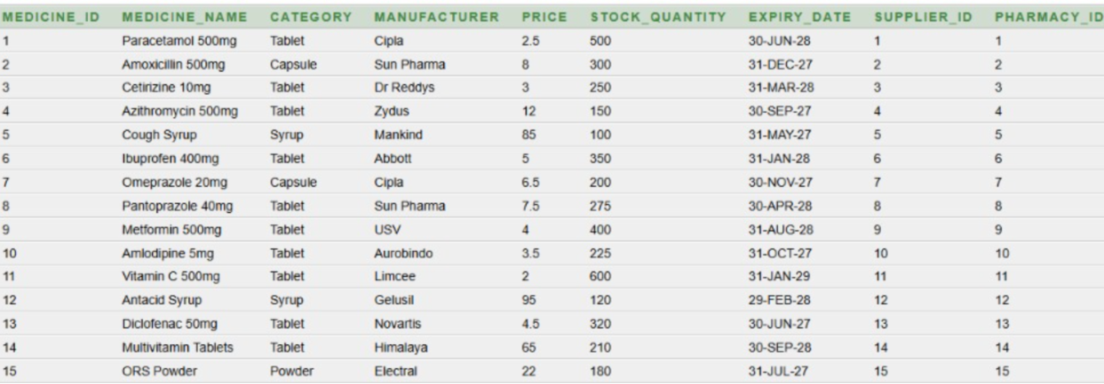
MEDICINES TABLE
CREATE TABLE Medicines1
(
Medicine_ID NUMBER PRIMARY KEY,
Medicine_Name VARCHAR2(100) NOT NULL,
Category VARCHAR2(50),
Manufacturer VARCHAR2(100),
Price NUMBER(10,2),
Stock_Quantity NUMBER,
Expiry_Date DATE,
Supplier_ID NUMBER,
Pharmacy_ID NUMBER,
FOREIGN KEY (Supplier_ID) REFERENCES Suppliers1(Supplier_ID),
FOREIGN KEY (Pharmacy_ID) REFERENCES Pharmacy1(Pharmacy_ID)
);

Slide 14
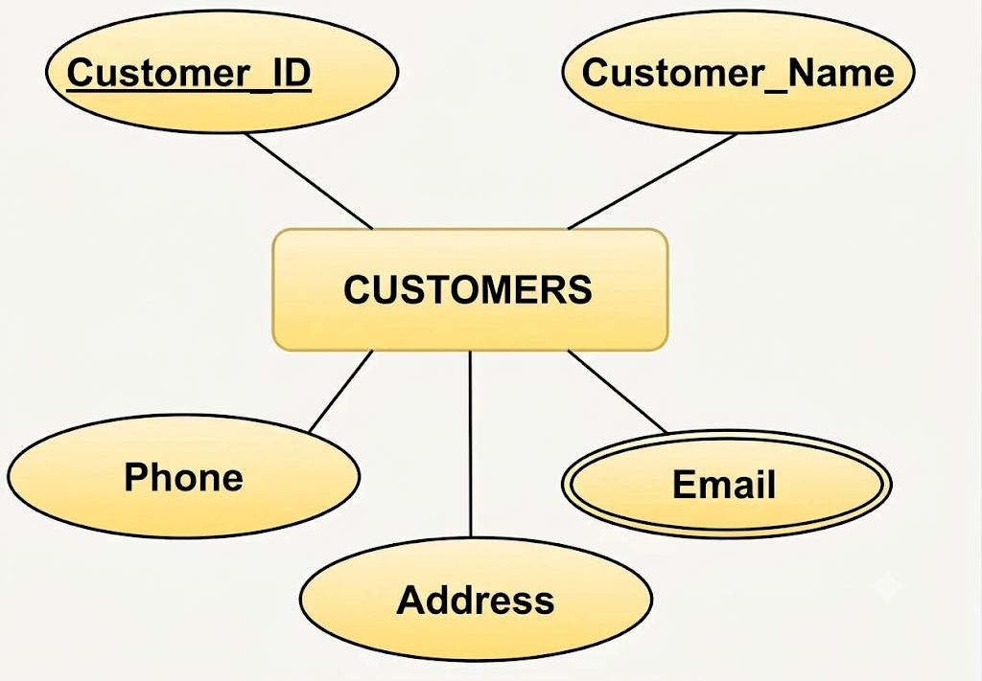
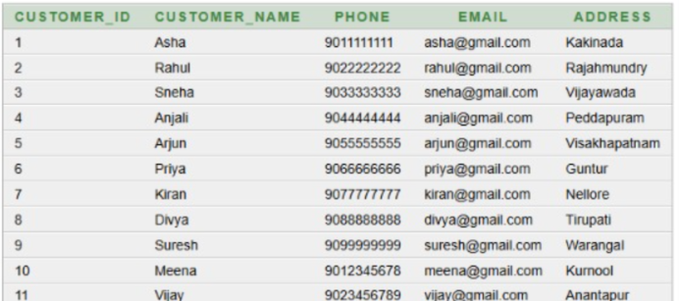
CUSTOMERS TABLE
CREATE TABLE Customers1
(
Customer_ID NUMBER PRIMARY KEY,
Customer_Name VARCHAR2(100) NOT NULL,
Phone VARCHAR2(15),
Email VARCHAR2(100),
Address VARCHAR2(255)
);

Slide 15
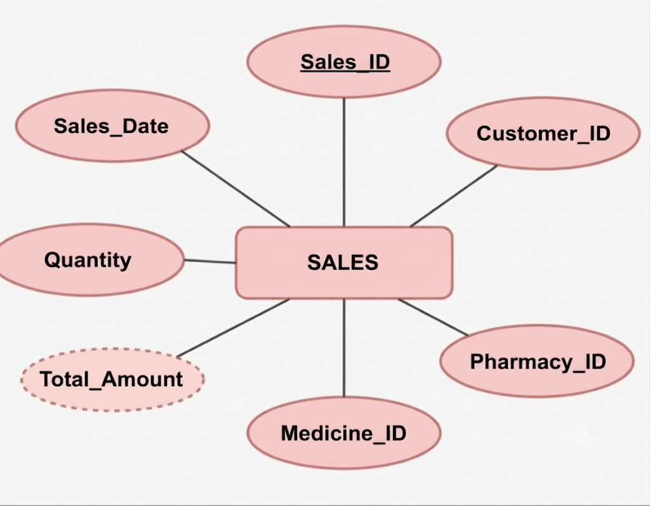
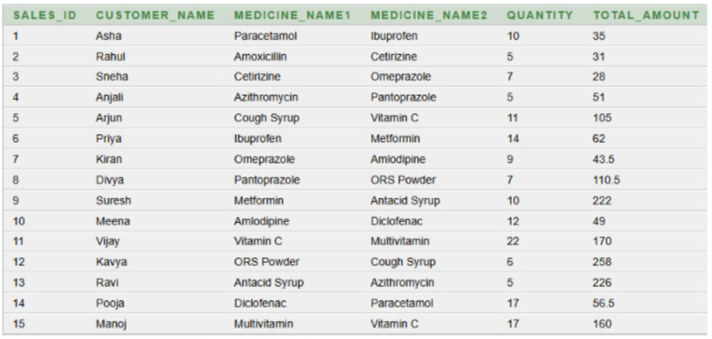
SALES TABLE
CREATE TABLE Sales1
(
Sales_ID NUMBER,
Customer_Name VARCHAR2(50),
Medicine_Name1 VARCHAR2(100),
Medicine_Name2 VARCHAR2(100),
Quantity NUMBER,
Total_Amount NUMBER(10,2)
);

Slide 16
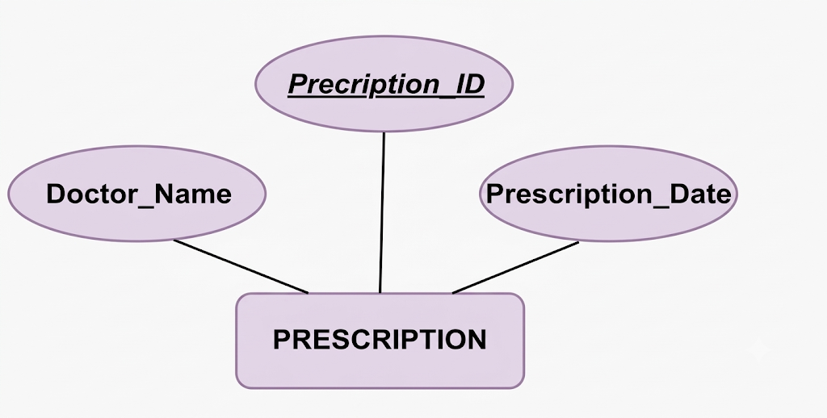
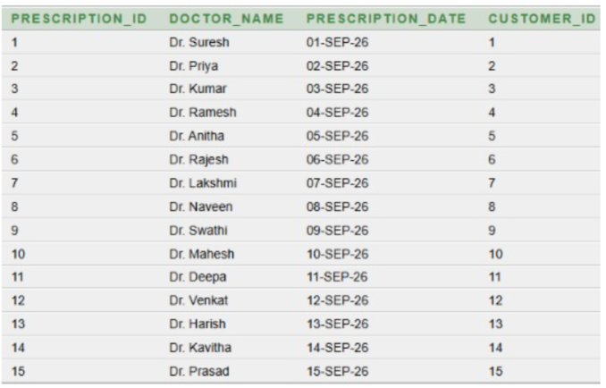
PRESCRIPTION TABLE
CREATE TABLE Prescription1
(
Prescription_ID NUMBER PRIMARY KEY,
Doctor_Name VARCHAR2(100),
Prescription_Date DATE,
Customer_ID NUMBER,
FOREIGN KEY (Customer_ID) REFERENCES Customers1(Customer_ID)
);

Slide 17

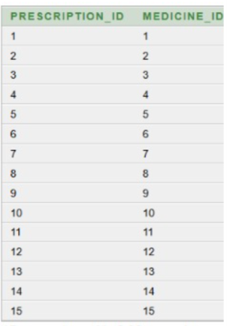
PRESCRIPTION_MEDICINE TABLE
CREATE TABLE Prescription_Medicine1
(
Prescription_ID NUMBER,
Medicine_ID NUMBER,
PRIMARY KEY (Prescription_ID, Medicine_ID),
FOREIGN KEY (Prescription_ID) REFERENCES Prescription1(Prescription_ID),
FOREIGN KEY (Medicine_ID) REFERENCES Medicines1(Medicine_ID)
);

Slide 18
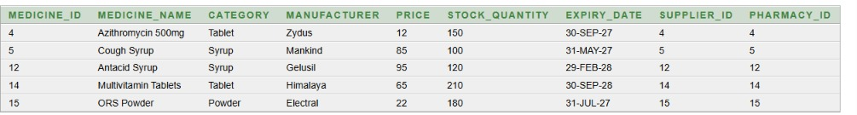
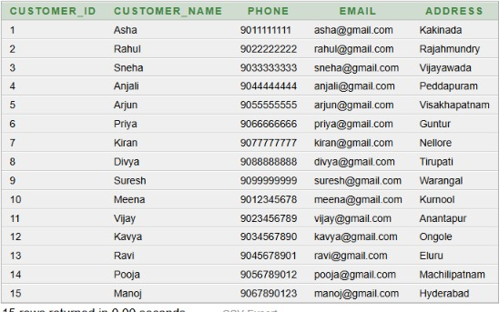
BASIC QUERIES
1. Display medicines whose price is greater than 10.
SELECT * FROM Medicines1WHERE Price > 10;
Display all records from the Customers1 table
2.
SELECT * FROM Customers1;

Slide 19
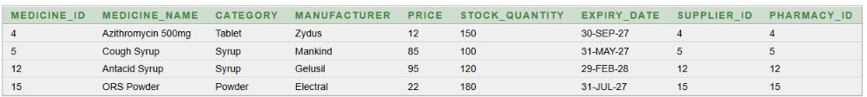
3.Display medicines whose stock quantity is less than 200.
SELECT * FROM Medicines1WHERE Stock_Quantity < 200;
4.Display customers who are from Hyderabad.
SELECT * FROM Customers1WHERE Address = 'Hyderabad';

Slide 20
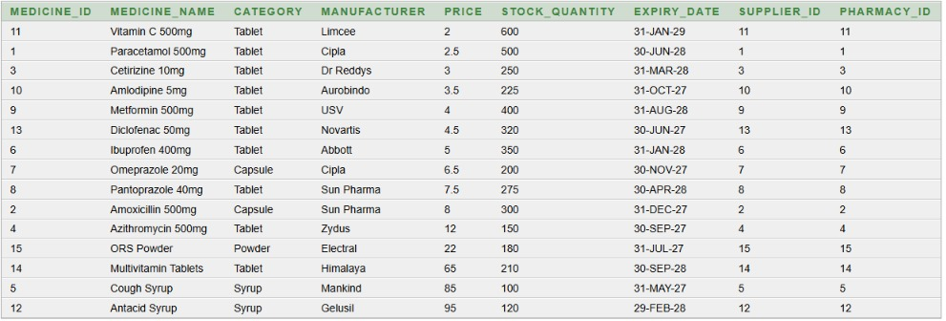

5.Display medicines in ascending order of price.
SELECT * FROM Medicines1ORDER BY Price ASC;
6. Display the total number of customers.
SELECT COUNT(*) AS Total_CustomersFROM Customers1;

Slide 21
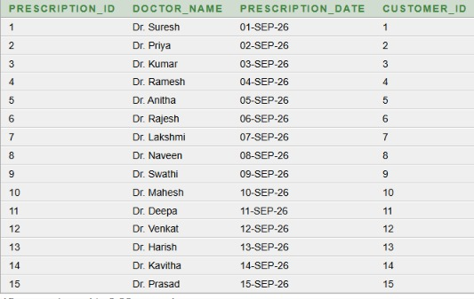
7. Display all records from the Prescription1 table
SELECT * FROM Prescription1;

Slide 22
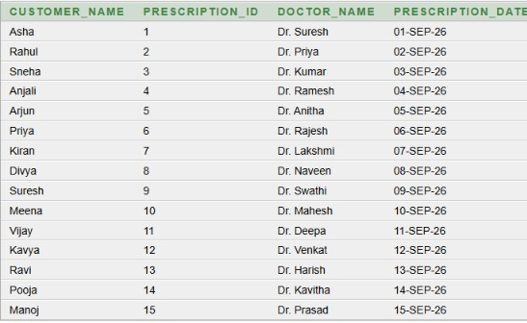
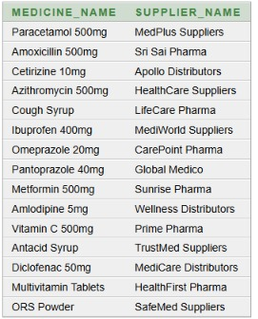
ADVANCED QUERIES
1.Display the customer name along with their prescription details.
SELECT C.Customer_Name,
P.Prescription_ID,
P.Doctor_Name,
P.Prescription_Date
FROM Customers1 C
JOIN Prescription1 P
ON C.Customer_ID = P.Customer_ID;
2.Display the medicine name along with its supplier name.
SELECT M.Medicine_Name,
S.Supplier_Name
FROM Medicines1 M
JOIN Suppliers1 S
ON M.Supplier_ID = S.Supplier_ID;

Slide 23
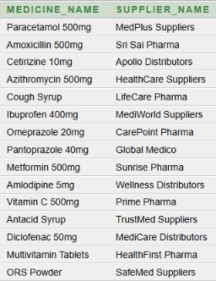
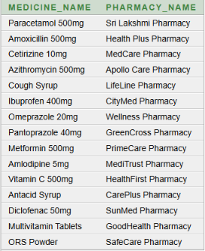
3.Display the medicine name along with the pharmacy name where it is available.
SELECT M.Medicine_Name,
S.Supplier_Name
FROM Medicines1 M
JOIN Suppliers1 S
ON M.Supplier_ID = S.Supplier_ID;
4.Find the most expensive medicine in the pharmacy.
SELECT M.Medicine_Name,
P.Pharmacy_Name
FROM Medicines1 M
JOIN Pharmacy1 P
ON M.Pharmacy_ID = P.Pharmacy_ID;

Slide 24
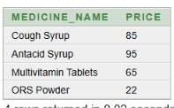
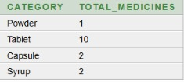
5.Find medicines whose price is greater than the average price of all medicines.
SELECT Medicine_Name,
Price
FROM Medicines1
WHERE Price > (SELECT AVG(Price)
FROM Medicines1);
6.Count the number of medicines available in each category.
SELECT Category,
COUNT(*) AS Total_Medicines
FROM Medicines1
GROUP BY Category;

Slide 25
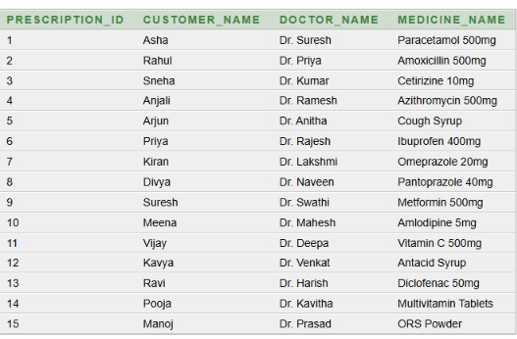
7.Display complete prescription details including prescription ID, customer name, doctor name, and medicine name.
SELECT P.Prescription_ID,
C.Customer_Name,
P.Doctor_Name,
M.Medicine_Name
FROM Prescription1 P
JOIN Customers1 C
ON P.Customer_ID = C.Customer_ID
JOIN Prescription_Medicine1 PM
ON P.Prescription_ID = PM.Prescription_ID
JOIN Medicines1 M
ON PM.Medicine_ID = M.Medicine_ID;

Slide 26
Normalization
Normalization is the process of organizing data into well-structured tables to reduce data redundancy and avoid insertion, update, and deletion anomalies.
Types of Normal Forms
1.First Normal Form (1NF)
In 1NF, each field contains a single value, and repeating groups are removed
2.Second Normal Form (2NF)
Must be in 1NF and removes partial dependency.
3.Third Normal Form (3NF)
Must be in 2NF and removes transitive dependency

Slide 27
FIRST NORMAL FORM
In 1NF, each field contains a single value, and repeating groups are removed from the Pharmacy Management System
Functional dependencies
SALES_ID → CUSTOMER_NAME, QUANTITY, TOTAL_AMOUNT
(SALES_ID, MEDICINE_NAME)→ identifies each medicine entry in a sale
Redundancy / Anomalies in 1NF:
• Customer and medicine details are repeated in multiple rows.
• Update anomaly: Changing customer or medicine details requires updating multiple rows.
• Insertion anomaly: A new medicine cannot be added without a sale or prescription.
• Deletion anomaly: Deleting a sale may also remove the only record of a medicine.

Slide 28
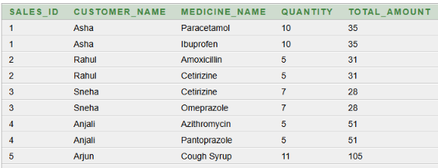
CREATE TABLE Sales_1NF
(
Sales_ID NUMBER, Customer_Name VARCHAR2(50), Medicine_Name VARCHAR2(100), Quantity NUMBER, Total_Amount NUMBER(10,2), PRIMARY KEY (Sales_ID, Medicine_Name)
);

Slide 29
SECOND NORMAL FORM
A relation is in 2NF when it is already in 1NF and has no partial dependency.
Functional dependencies
SALES_ID → CUSTOMER_NAME
SALES_ID → QUANTITY
SALES_ID → TOTAL_AMOUNT
(SALES_ID, MEDICINE_NAME)→ identifies the sale-medicine combination
Redundancy / Anomalies in 2NF
• Customer details are stored only in CUSTOMERS1, once per Customer_ID.
• Medicine details are stored only in MEDICINES1, once per Medicine_ID.
• Sales details are stored separately in SALES1.
• Multiple medicines are linked through SALE_MEDICINE1 without repeating customer details.

Slide 30
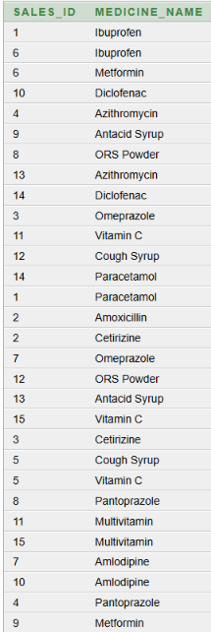
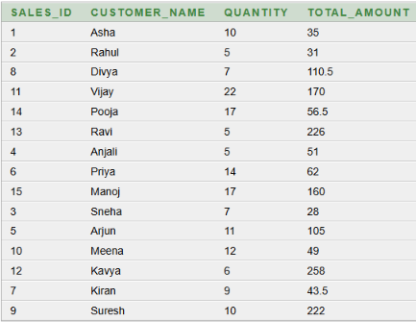
Conversion from 1NF to 2NF
The 1NF relation has a composite key (SALES_ID, MEDICINE_NAME).
CUSTOMER_NAME, QUANTITY, and TOTAL_AMOUNT depend only on SALES_ID.
This is a partial dependency. To remove the partial dependency, the relation is divided into two tables
CREATE TABLE Sales_2NF
( Sales_ID NUMBER PRIMARY KEY, Customer_Name VARCHAR2(50), Quantity NUMBER, Total_Amount NUMBER(10,2) );

Slide 31
THIRD NORMAL FORM
A relation is in 3NF when it is in 2NF and contains no transitive dependency
FUNCTIONAL DEPENDENCIES – 3NF
1. SALES_ID → CUSTOMER_ID, QUANTITY, TOTAL_AMOUNT
2. CUSTOMER_ID → CUSTOMER_NAME
3. MEDICINE_ID → MEDICINE_NAME
Redundancy / Anomalies in 3NF
Update anomaly removed: If a customer’s name or details change, we update the customer information only once in the Customers1 table.
Insertion anomaly removed: A new customer can be added to Customers1 even before the customer makes a sale.
Deletion anomaly removed: Deleting a sale from Sales_3NF does not delete the customer or medicine information from Customers1 or Medicines1.

Slide 32
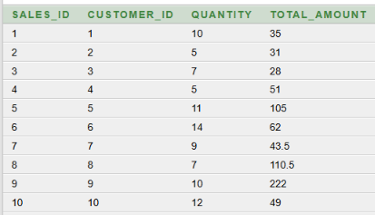
Conversion from 2NF to 3NF
In 2NF, customer and medicine names are still stored as descriptive attributes.
To achieve 3NF, customer and medicine information are represented using their IDs.
The existing Customers1 and Medicines1 tables are used as master tables.
CREATE TABLE Sales_3NF (
Sales_ID NUMBER PRIMARY KEY,
Customer_ID NUMBER,
Quantity NUMBER,
Total_Amount NUMBER(10,2),
FOREIGN KEY (Customer_ID)
REFERENCES Customers1(Customer_ID)
);

Slide 33
CONCLUSION
The Pharmacy Management System provides an efficient way to manage medicines, customers, suppliers, sales, and purchases. It helps track stock and expiry dates, reduces manual work and errors, and keeps pharmacy data organized, accurate, and easy to access.

Slide 34


